Slide 1
HNDIT-1214 Statistics for IT
2. Organizing and Summarizing Data

Slide 2
Course Objectives
After completing this module, students should be able to
Recognize different types of data
Describe data presented as a list
Describe discrete data presented in a table
Describe continuous data presented in a grouped frequency table

Slide 3
RAW DATA
Raw data are collected data that have not been organized numerically.
An example is the set of heights of 100 male students obtained from an alphabetical listing of university records.

Slide 4
ARRAYS
An array is an arrangement of raw numerical data in ascending or descending order of magnitude.
Eg.
Arrange the numbers 17, 45, 38, 27, 6, 48, 11, 57, 34, and 22 in an array.
SOLUTION
In ascending order of magnitude, the array is: 6, 11, 17, 22, 27, 34, 38, 45, 48, 57.
In descending order of magnitude, the array is: 57, 48, 45, 38, 34, 27, 22, 17, 11, 6.

Slide 5
Range
The difference between the largest and smallest numbers is called the range of the data.
For example,
if the largest height of 100 male students is 74 inches (in) and the smallest height is 60 in, the range is 74 - 60 = 14 in.

Slide 6
Data
The first step in summarizing quantitative data is to determine whether the data is discrete or continuous.
If the data is discrete, the categories of data will be the observations (as in qualitative data),
if the data is continuous, the categories of data (called classes) must be created using intervals of numbers.

Slide 7
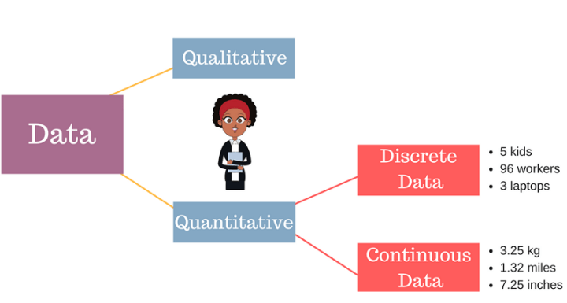

Slide 8
Discrete data - Frequency Table

Slide 9
Discrete data - Frequency Table (cont...)
Example 01
The following data represent the number of available cars in a household based on a random sample of 50 households.
Construct a frequency and relative frequency distribution.
3 | 0 | 1 | 2 | 1 | 1 | 1 | 2 | 0 | 2
4 | 2 | 2 | 2 | 1 | 2 | 2 | 0 | 2 | 4
1 | 1 | 3 | 2 | 4 | 1 | 2 | 1 | 2 | 2
3 | 3 | 2 | 1 | 2 | 2 | 0 | 3 | 2 | 2
2 | 3 | 2 | 1 | 2 | 2 | 1 | 1 | 3 | 5

Slide 10

Frequency and Relative Frequency Table
A frequency table is constructed by arranging collected data values in ascending order of magnitude with their corresponding frequencies
A relative frequency is the fraction of times an answer occurs. To find the relative frequencies, divide each frequency by the total number of students in the sample
$$Relative frequency=\frac{Frequency}{total number of frequencies }$$

Slide 11
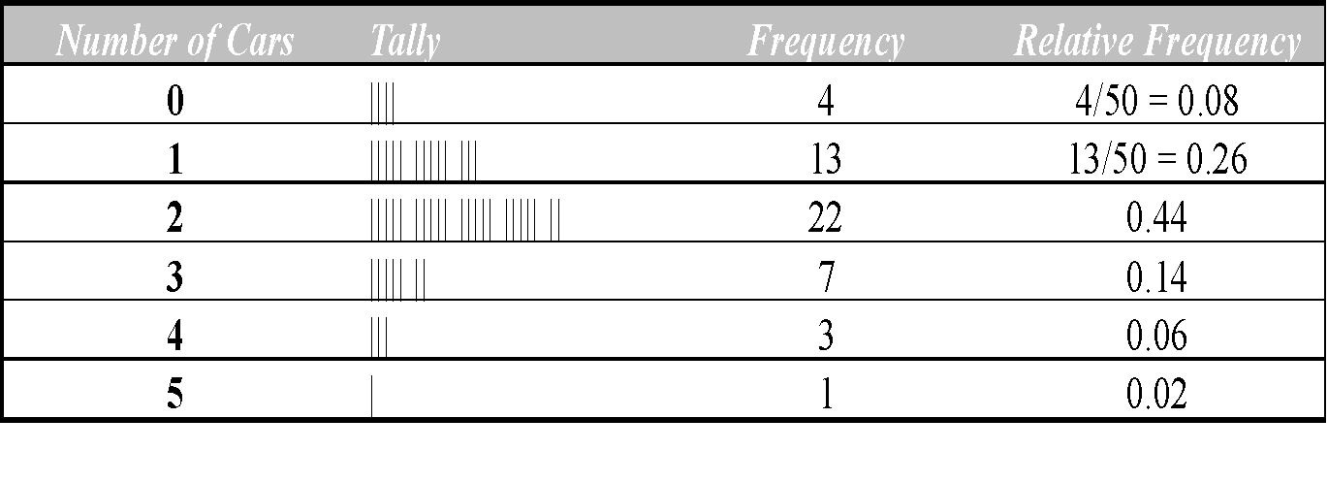
Frequency and Relative Frequency Table

Slide 12
Continuous data - Grouped frequency table

Slide 13
Grouped frequency table- Terms
Class interval.
Class limits.
Class Boundaries.
Class width.
Class Marks.

Slide 14
Grouped frequency table- Terms
The following data represents the height of 100 student who are following HNDIT course .
Class Interval
A symbol defining a class, such as 60–62 in the given table, is called a class interval.
Height (in) | No of Student
60-62 | 5
63-65 | 18
66-68 | 42
69-71 | 27
72-74 | 8
 | Total 100

Slide 15
Grouped frequency table- Terms
Class Limits
The end numbers, 60 and 62, are called class limits; the smaller number (60) is the lower class limit, and the larger number (62) is the upper class limit.
Open Class Intervals
A class interval that, at least theoretically, has either no upper class limit or no lower class limit indicated is called an open class interval.
For example, referring to age groups of individuals, the class interval ‘‘65 years and over’’ is an open class interval.

Slide 16
Grouped frequency table- Terms
Class Boundaries
If heights are recorded to the nearest inch, the class interval 60–62 theoretically includes all measurements from 59.5000 to 62.5000 in.
These numbers, 59.5 and 62.5, are called class boundaries, the smaller number (59.5) is the lower class boundary, and the larger number (62.5) is the upper class boundary.

Slide 17
Grouped frequency table- Terms
The Size, or Width, of a Class Interval
The size, or width, of a class interval is the difference between the lower and upper class boundaries and is also referred to as the class width, class size, or class length.
If all class intervals of a frequency distribution have equal widths, this common width is denoted by c. In such case c is equal to the difference between two successive lower class limits or two successive upper class limits.

Slide 18
Grouped frequency table- Terms
The Class Mark (Midpoint)
The class mark is the midpoint of the class interval and is obtained by adding the lower and upper class limits and dividing by 2.
Eg.
class mark of the interval 60–62 =(60+62)/2= 61.

Slide 19
GENERAL RULES FOR FORMING FREQUENCY DISTRIBUTIONS
Determine the largest and smallest numbers in the raw data and thus find the range.
Divide the range into a convenient number of class intervals having the same size. The number of class intervals is usually between 5 and 20, depending on the data.
Determine the number of observations falling into each class interval; that is, find the class frequencies.

Slide 20
Continuous data - Grouped frequency table
Example 02
These data represent the record high temperatures in degrees Fahrenheit (F) for each of the 50 states. Construct a grouped frequency distribution for the data using 7 classes.
Construct a histogram to represent the data shown for the record high temperatures for each of the 50 states.
construct a frequency polygon.

Slide 21
Example 02 Answer
Round the answer up to the nearest whole number if there is a remainder:
Subtract one unit from the lower limit of the second class to get the upper limit of the first class. Then add the width to each upper limit to get all the upper limits.
105 - 1 = 104
The first class is 100–104, the second class is 105–109, etc.

Slide 22
Grouped frequency distribution

Slide 23
Construct a histogram

Slide 24
The Frequency Polygon
Another way to represent the same data set is by using a frequency polygon.
The frequency polygon is a graph that displays the data by using lines that connect points plotted for the frequencies at the midpoints of the classes. The frequencies are represented by the heights of the points.

Slide 25
Construct a Frequency Polygon
Find the midpoints of each class.
Class Boundaries | Mid Points | Frequency
99.5-104.5 | 102 | 2
104.5-109.5 | 107 | 8
109.5-114.5 | 112 | 18
114.5-119.5 | 117 | 13
119.5-124.5 | 122 | 7
124.5-129.5 | 127 | 1
129.5-134.5 | 132 | 1

Slide 26
Construct a Frequency Polygon

Slide 27
The Ogive
The ogive is a graph that represents the cumulative frequencies for the classes in a frequency distribution.

Slide 28
Class Boundaries | Mid Points | Frequency | Less Than Cumulative Frequency | MoreThan Cumulative Frequency
 | 97 |  | 0 | 50
99.5-104.5 | 102 | 2 | 2 | 48
104.5-109.5 | 107 | 8 | 10 | 40
109.5-114.5 | 112 | 18 | 28 | 22
114.5-119.5 | 117 | 13 | 41 | 9
119.5-124.5 | 122 | 7 | 48 | 2
124.5-129.5 | 127 | 1 | 49 | 1
129.5-134.5 | 132 | 1 | 50 | 0
 | 137 |  | 50 | 0

Slide 30
Exercises 01
Table shows a frequency distribution of the weekly wages of 65 employees at the P&R
Company. With reference to this table, determine:
(a) The lower limit of the sixth class.
(b) The upper limit of the fourth class.
(c) The class mark (or class midpoint) of the third class.
(d) The class boundaries of the fifth class.
(e) The size of the fifth-class interval.
( f ) The frequency of the third class.
(g) The relative frequency of the third class.
(h) The class interval having the largest frequency.
This is sometimes called the modal class
interval; its frequency is then called the modal class frequency.
(i) The percentage of employees earning less than $280.00 per week.
( j) The percentage of employees earning less than $300.00 per week but at least $260.00 per week.

Slide 31
Exercises 02
Prof Munidewa is the head of Department of Statics and wishes to determine the amount of studying hours of students do. He selects a random sample of 30 students and determines the number of hours each students studies per week.
Construct a frequency and relative frequency distribution.(Starting class 10.3-15.2, Class width 5)
Draw a Histogram and Frequency Polygon
Construct a Cumulative relative frequency distribution.
Draw Less than and more than Cumulative relative frequency distribution Curves(Ogive)
15.0 | 23.7 | 19.7 | 15.4 | 18.3 | 23.0 | 14.2 | 20.8 | 13.5 | 20.7
17.4 | 18.6 | 12.9 | 20.3 | 13.7 | 21.4 | 18.3 | 29.8 | 17.1 | 18.9
10.3 | 26.1 | 15.7 | 14.0 | 17.8 | 33.8 | 23.2 | 12.9 | 27.1 | 16.6

